Slide 1
A Study on The Real-Time Anomaly Detection of Wafer
Using Feature Distance and Self-Supervised Learning
使用特徵距離與自監督學習於即時晶圓瑕疵
異常偵測之研究
學生 : 黃一恩
指導教授 : 吳俊霖 教授

Slide 2
Outline
Introduction
Methodology
Experiments
Related work
Conclusion

Slide 3
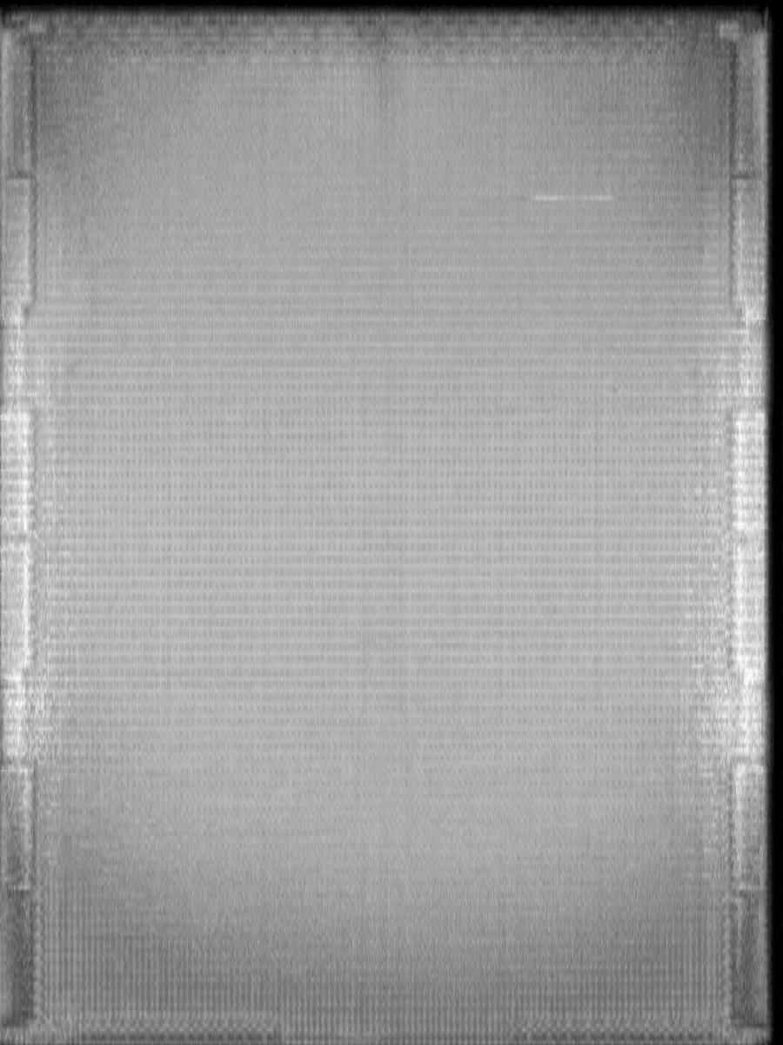
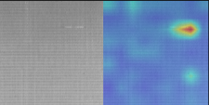
Introduction
We will obtain image from AOI machine and we need to judge this image that is pass or defect
and mark defect location on image

Slide 4
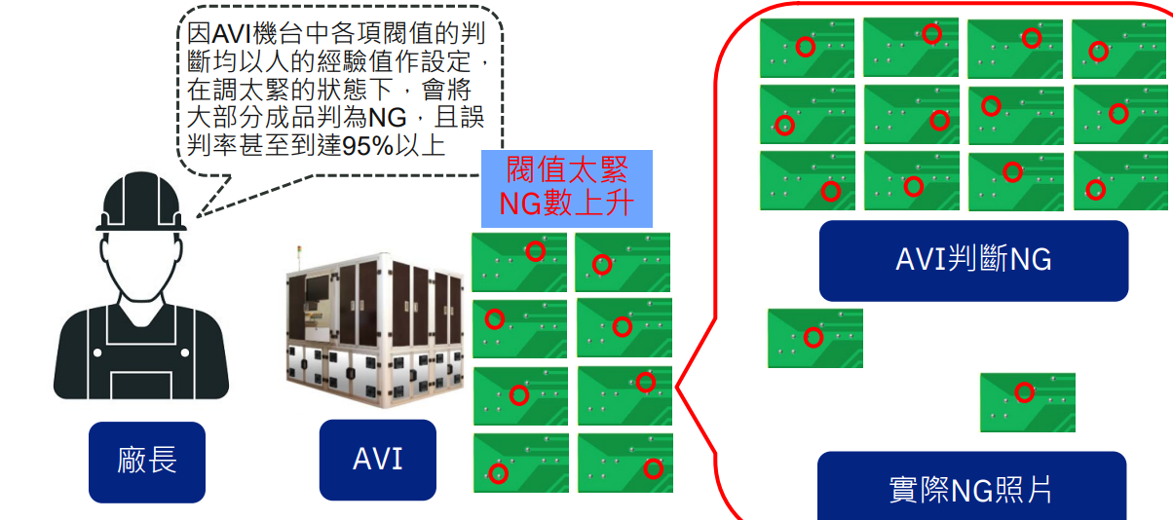
Introduction
In traditional AOI machine that use compare
method so if have tiny difference it will judge
defect that cause high overkill.

Slide 5
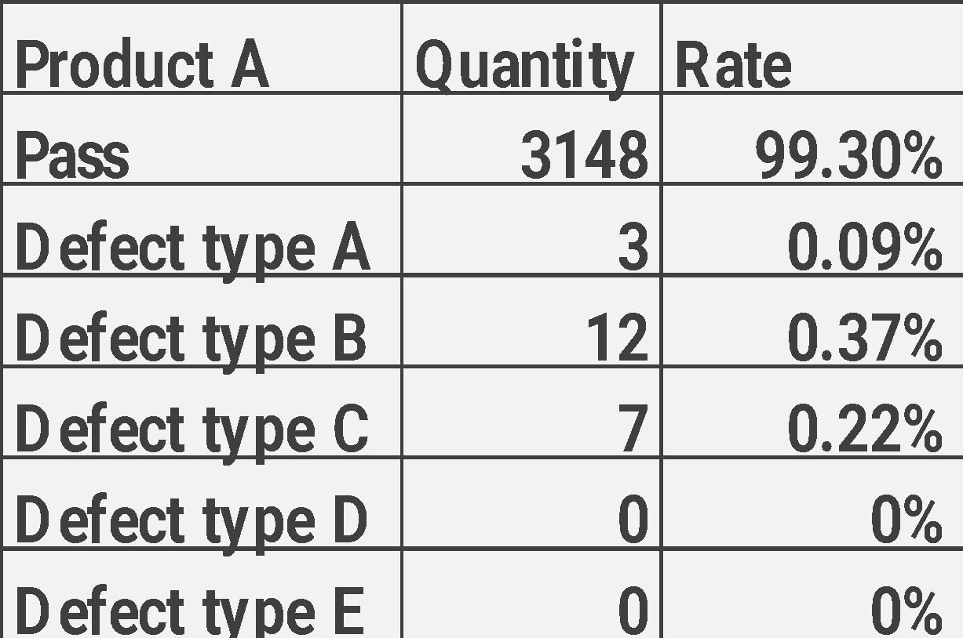
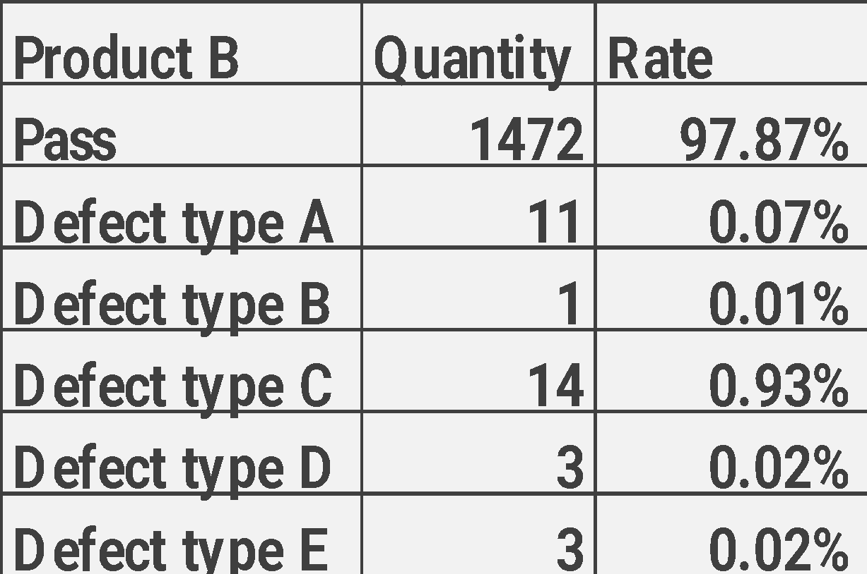
Introduction
It is collect data type distribution in 2023 W45
In our work , we have imbalance data issue in
some product even without any defect.

Slide 6
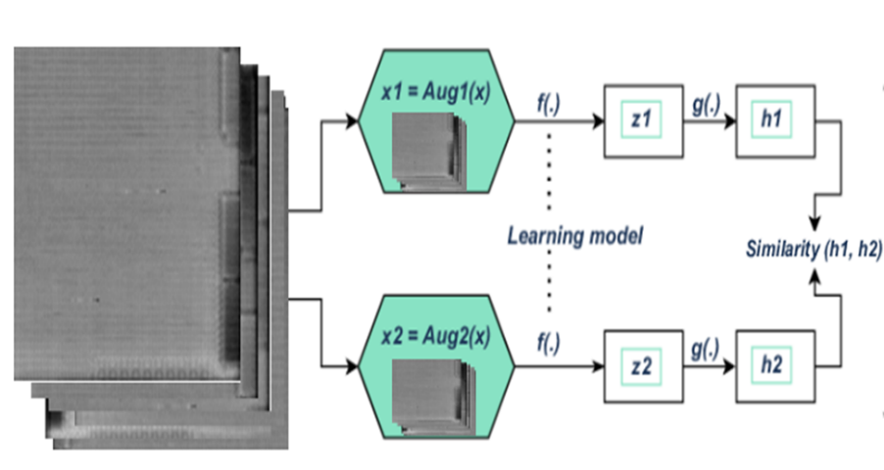
Related work
Self-supervised
It can use unlabel data to improve model’s feature
extraction performance
Methods like:
1. ICML (A Simple Framework for Contrastive Learning of
Visual Representations) [2020]

Slide 7
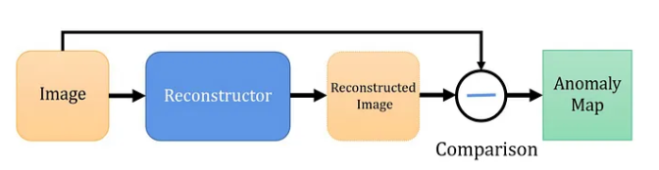
Related work
Reconstruction based
It will compare reconstructed image to original image
if they have difference pattern that is defect
Methods like:
1. IEEE (Memorizing Normality to Detect Anomaly) [2019]

Slide 8
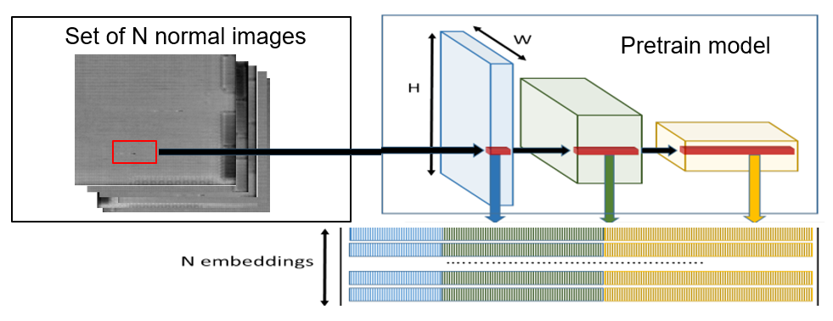
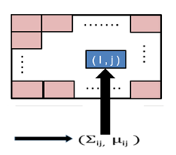
Related work
Representation based
Through calculate test sample to pass feature
distance to judge it is pass or defect
Methods like:
1. ICPR (A Patch Distribution Modeling Framework for
Anomaly Detection and Localization) [2020]

Slide 9
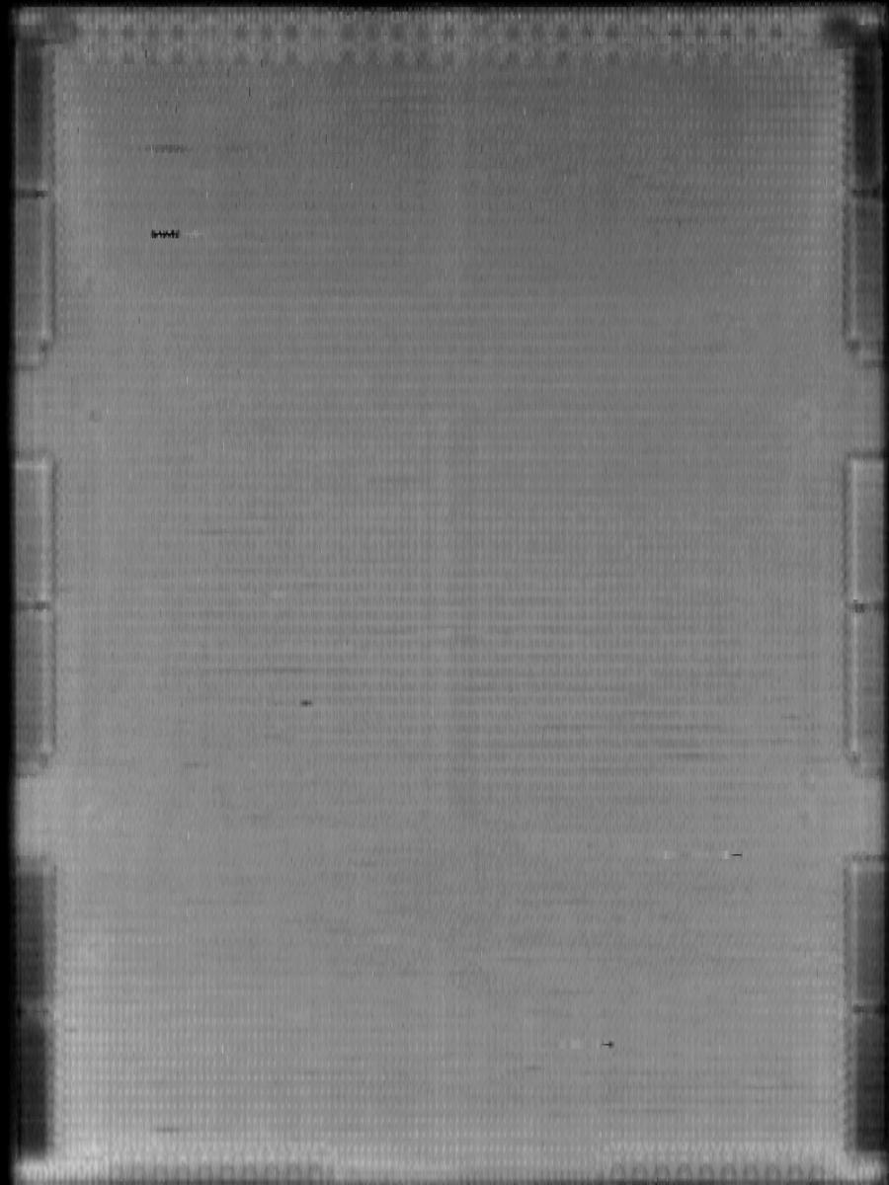
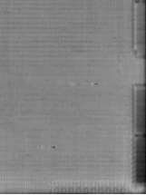
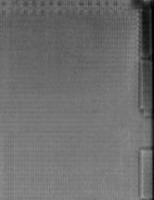
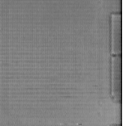
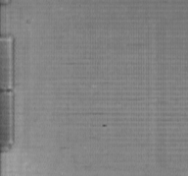
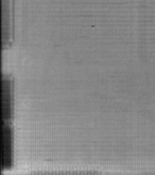
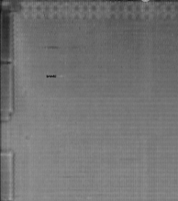
Proposed Scheme
Image Preprocess
Image size = 900x1200
Image size = 224x224
1
2
Divide to 6 patch(600x600)
And Resize to (224x224)
3
4
5
6

Slide 10
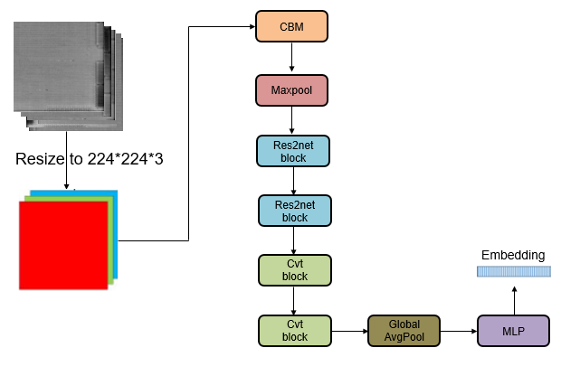
Proposed Scheme
112x112x32
56x56x32
56x56x128
28x28x256
14x14x512
7x7x1024
1x1x1024
It is our model structure , we use hybrid structure
(res2net and convolution vision transformer) to
improve out feature extraction performance

Slide 11
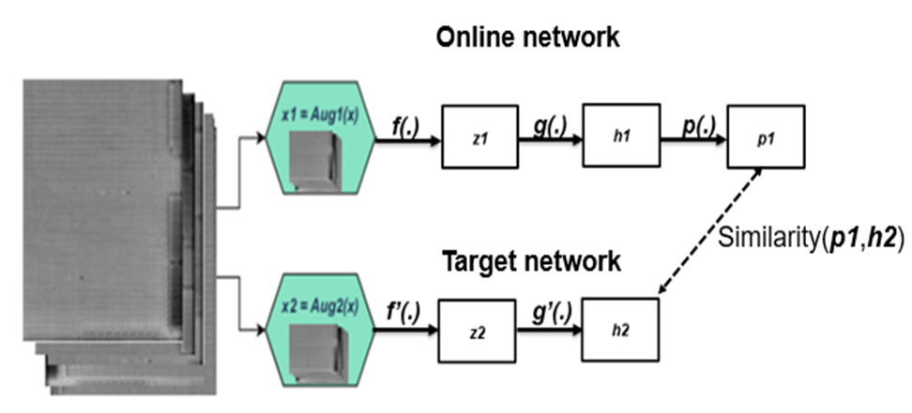
Proposed Scheme
We will use self-supervised method training our feature
extraction model.
Through asymmetric structure ,we can only use positive pair training model.

Slide 12
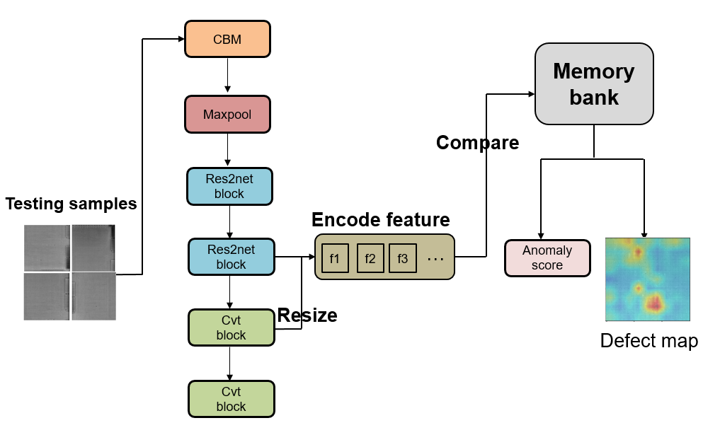
Proposed Scheme
112x112x32
56x56x32
56x56x128
It is our anomaly detection model structure , we will use
feature extraction model to collect pass feature to
memory bank and through feature distance to judge
testing data is defect or pass and mask it’s defect
location

Slide 13
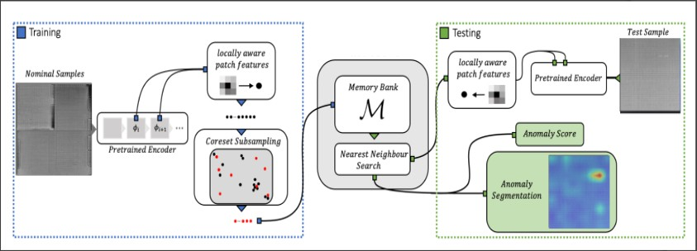
Proposed Scheme
In training stage we will use pretrain model to extract
normal sample feature to memory bank .
In testing stage , we will extract test sample feature to find nearest normal sample in memory bank and
calculate anomaly score

Slide 14
Proposed Scheme
Greedy coreset selection
If our sampling quantity is large , In testing stage it
will need a lot of time to calculate so we will use
greedy coreset selection to filter normal feature

Slide 15
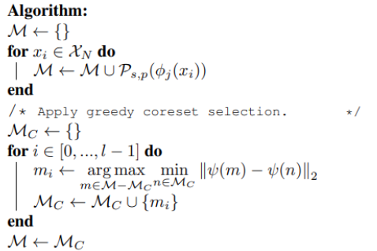
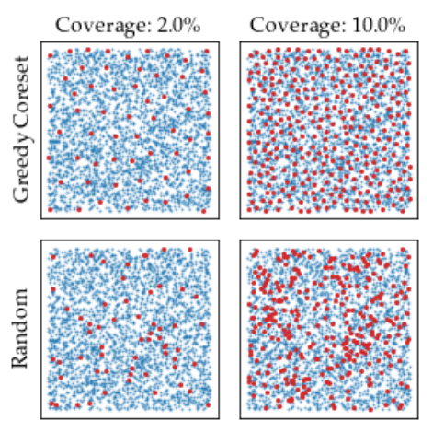
Proposed Scheme
Greedy coreset selection
Define Pretrained φ, hierarchies j, nominal data X , stride s, patchsize p, coreset target l, random linear projection ψ , Memory bank M

Slide 16
Proposed Scheme
Anomaly score calculation
With the nominal patch-feature memory bank M, we estimate the image-level anomaly score for a test image

Slide 17
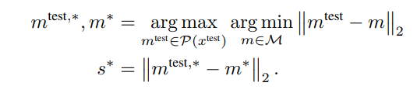
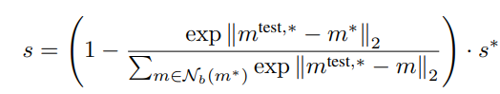
Proposed Scheme
Anomaly score calculation
We estimate the image-level anomaly score s for a test image x^{test} by the maximum distance score s∗ between test patch features in its patch collection
P(x ^{test}) = Ps,p(φj (x^{test})) to each respective nearest neighbour m∗ in M

Slide 18
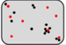
Proposed Scheme
Training stage
Image size = 224x224
Extract 10% feature
Subsampling
Patchcore
Memory
bank
Pretrain encoder
(28x28x768)
Pretrain model structure : res2net+transformer
Pretrain method : BYOL (self-supervise)
Pretrain dataset : Our product data (30M)
Parameter num : 12M

Slide 19
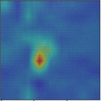
Proposed Scheme
Testing stage
Image size = 224x224
Nearest neighbor
Search
Patchcore
Memory
bank
Anomaly score
Pretrain encoder
(28x28x768)
Pretrain model structure : res2net+transformer
Pretrain method : BYOL (self-supervise)
Pretrain dataset : Our product data (30M)
Parameter num : 12M
Anomaly
segmentation

Slide 20
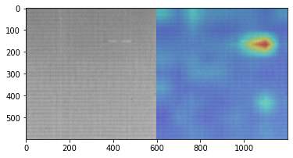
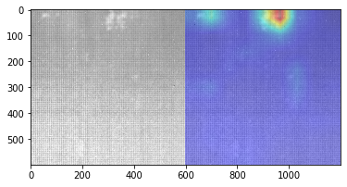
EXPERIMENTS
Product A
Void defect
Product A
Bubble defect

Slide 21
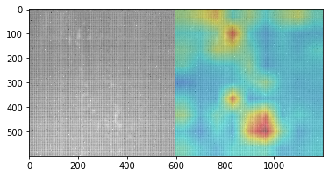
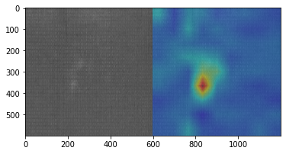
EXPERIMENTS
Product A
Burst defect
Product B
Delam defect

Slide 22
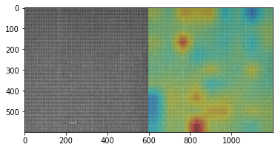
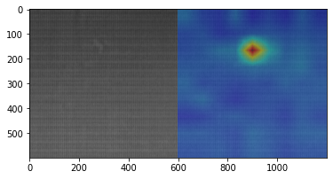
EXPERIMENTS
Product B
Linear defect
Product B
Chemical defect

Slide 23
EXPERIMENTS
Pretrain model comparison
Product A
方法 | Precision | Recall | F1-Measure
Imagenet 權重 | 61.48% | 50.39% | 55.38%
所提 self-supervise | 100.00% | 98.68% | 99.29%
Product B
方法 | Precision | Recall | F1-Measure
Imagenet 權重 | 73.51% | 37.12% | 49.33%
所提 self-supervise | 100.00% | 95.61% | 97.75%

Slide 24
EXPERIMENTS
Anomaly detection model comparison
Product A
方法 | Precision | Recall | F1-Measure
PaDim | 100.00% | 94.41% | 98.17%
所提Anomaly detection | 100.00% | 98.68% | 99.29%
Product B
方法 | Precision | Recall | F1-Measure
PaDim | 98.23% | 90.44% | 94.17%
所提Anomaly detection | 100.00% | 95.61% | 97.75%

Slide 25
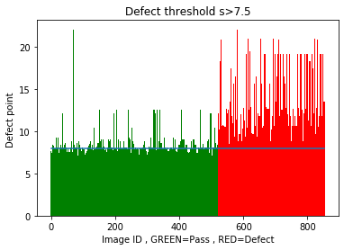
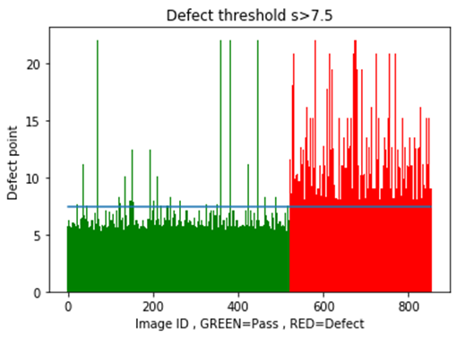
EXPERIMENTS
Memory feature usage comparison
方法 | Precision | Recall | F1-Measure | Throughput
1% | 100.00% | 78.95% | 84.23% | 72img/1s
15% | 100.00% | 95.61% | 97.75% | 60img/1s
30% | 100.00% | 96.03% | 97.97% | 43img/1s
Use 1% memory feature
Use 15% memory feature

Slide 26
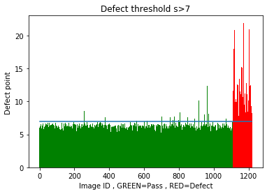

EXPERIMENTS
Product A Product B
Patchcore 15%
Patchcore 15%
Axis Y is anomaly score
Axis X is testing image
Green pattern is pass
Red pattern is defect

